Slide 1




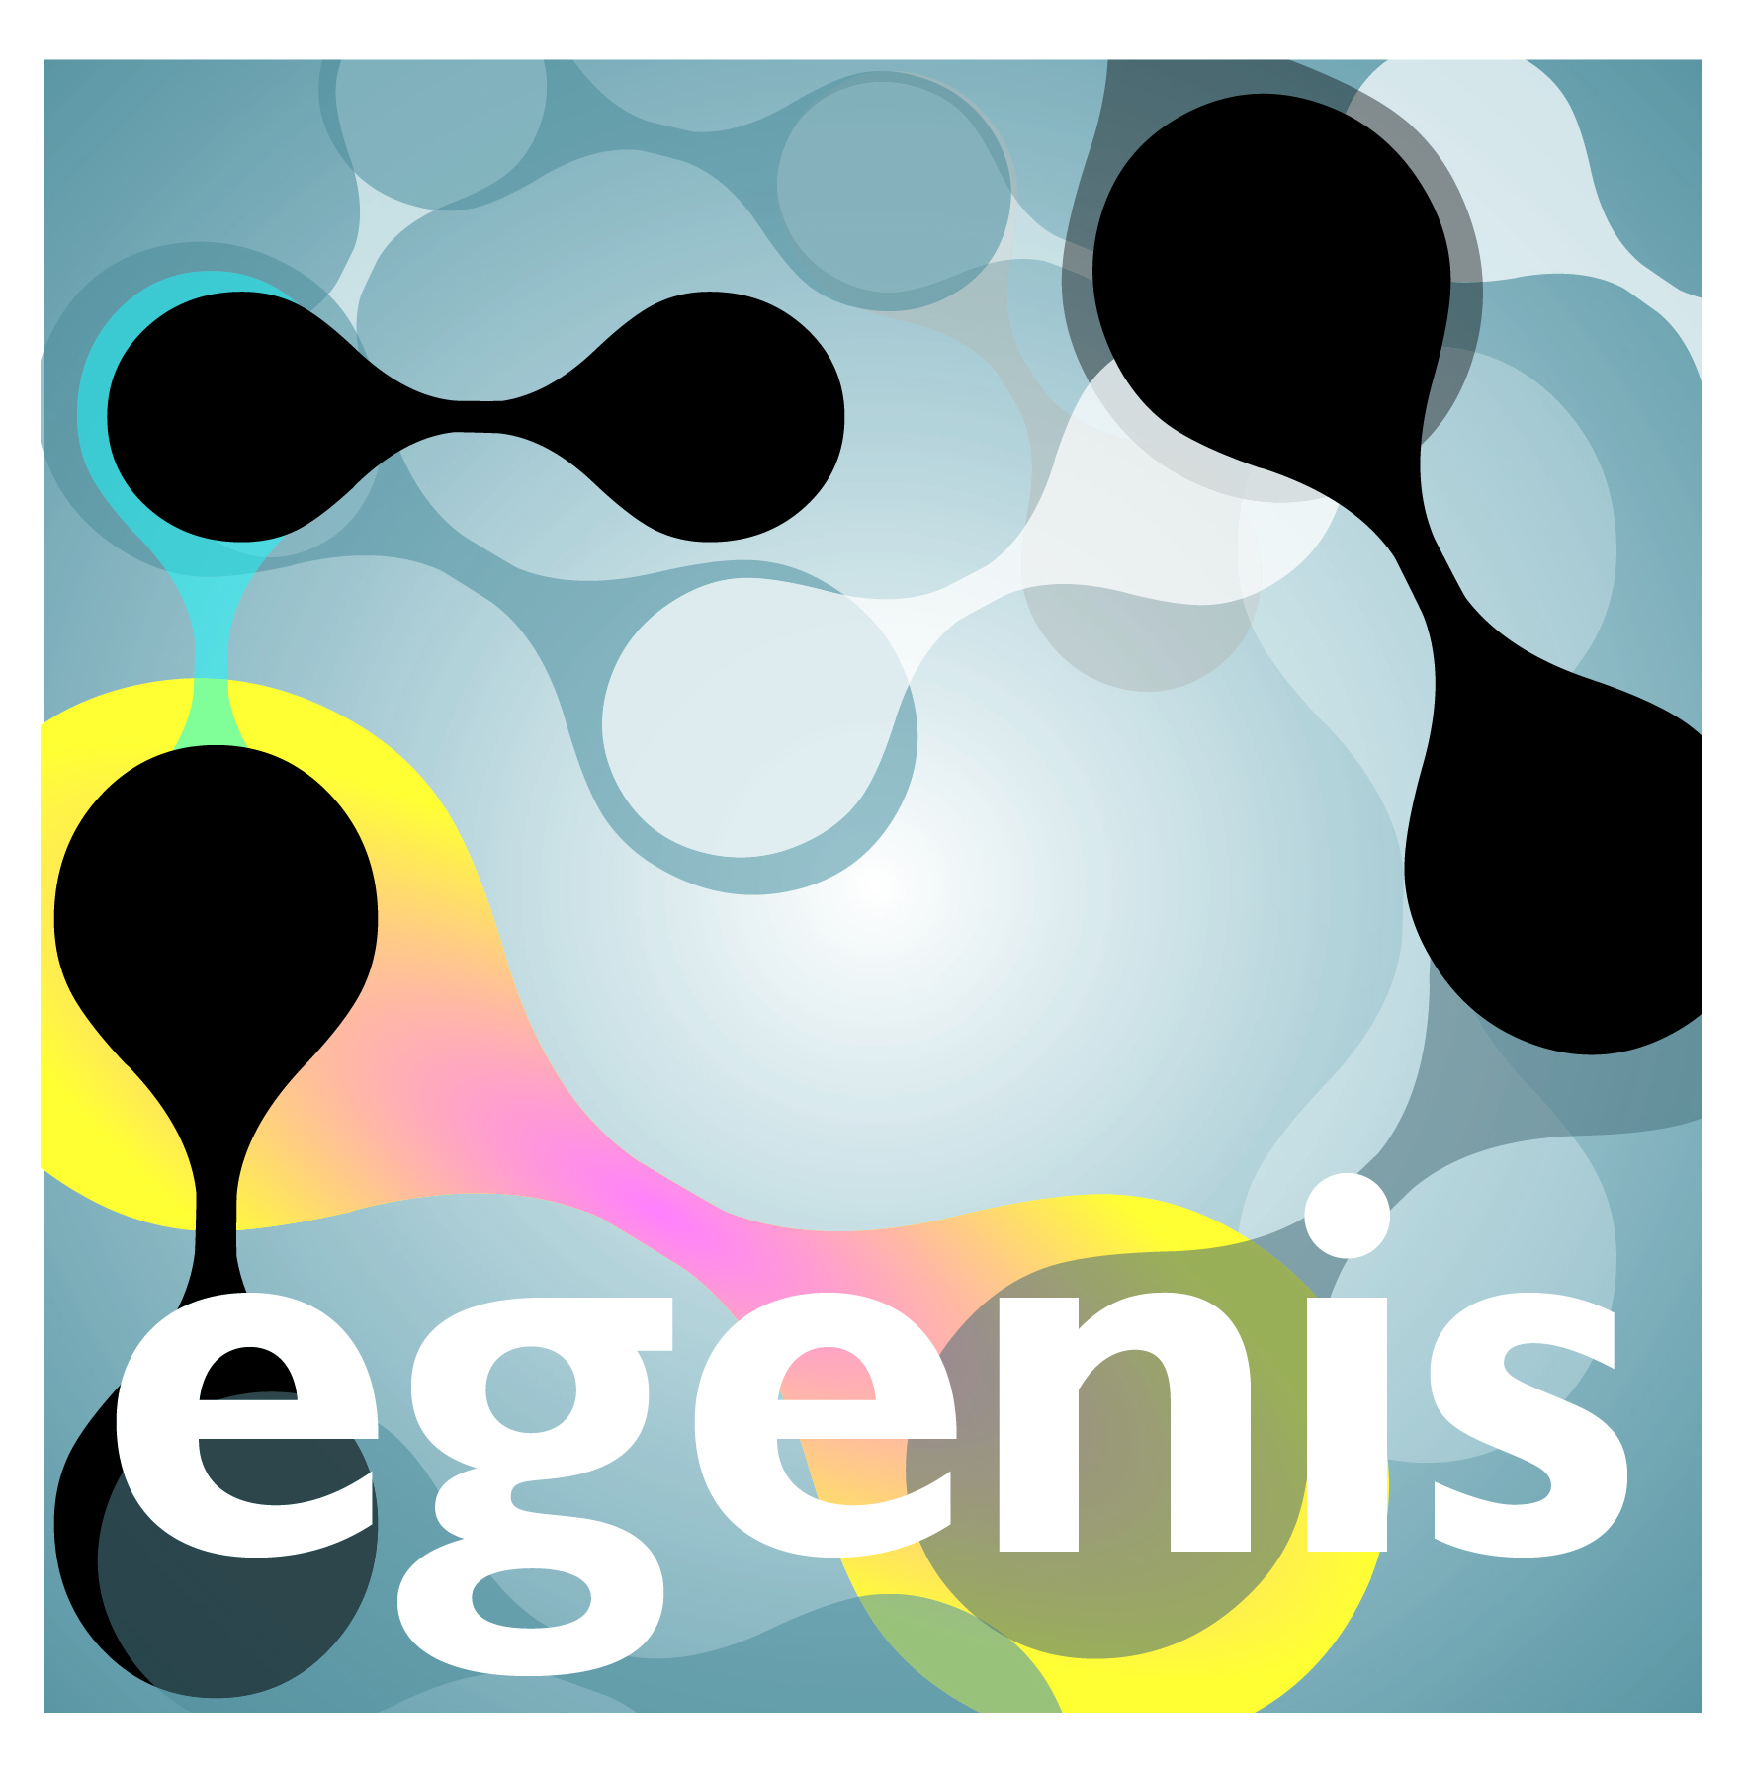
Open Science: Diversity and Injustice
Nathanael Sheehan
Exeter Centre for the Study of Life Sciences
(Egenis), University of Exeter
@thanaelsheehan

Slide 2

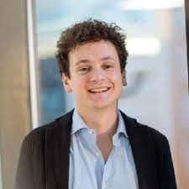

Team
Sabina Leonelli
Federico Botta
ME
(Not Lou-Lou or Itsi and Bitsi)

Slide 3


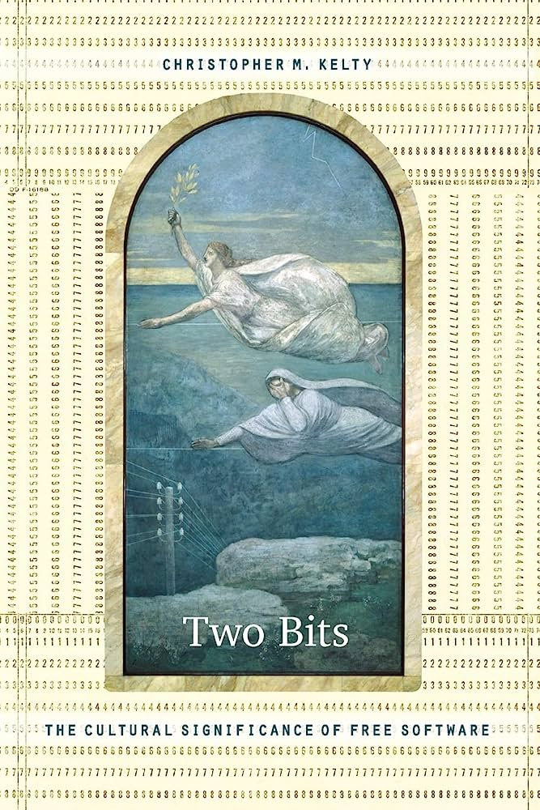

Histories of Openness in Science
• Openness as the circulation of materials
• Across borders: collection practices in colonial history
• Across groups: community ethos in 20th century model organism biology repertoire
• Openness as opportunity for meritocratic scrutiny
• Institutionalized publication: feedback from recognized experts (Phil Trans 1665);
• Mertonian norms (1942): communism, universalism, disinterestedness, organized skepticism;
• Longino’s conditions (2002): venues; uptake; public standards; tempered equality
• Openness as condition for individual freedom
• Science models society: 1945 Open Society as ‘social philosophy for our time’
• The very possibility of personal choice and responsibility
• Against historicism and the impulse to predict (‘the future is open’)
• Openness as a reaction to / endorsement of novel forms of commodification
• in research: late 70s
• in software development: early 1980s (Kelty 2007)
• back to ‘Open Science’: 1985

Slide 4
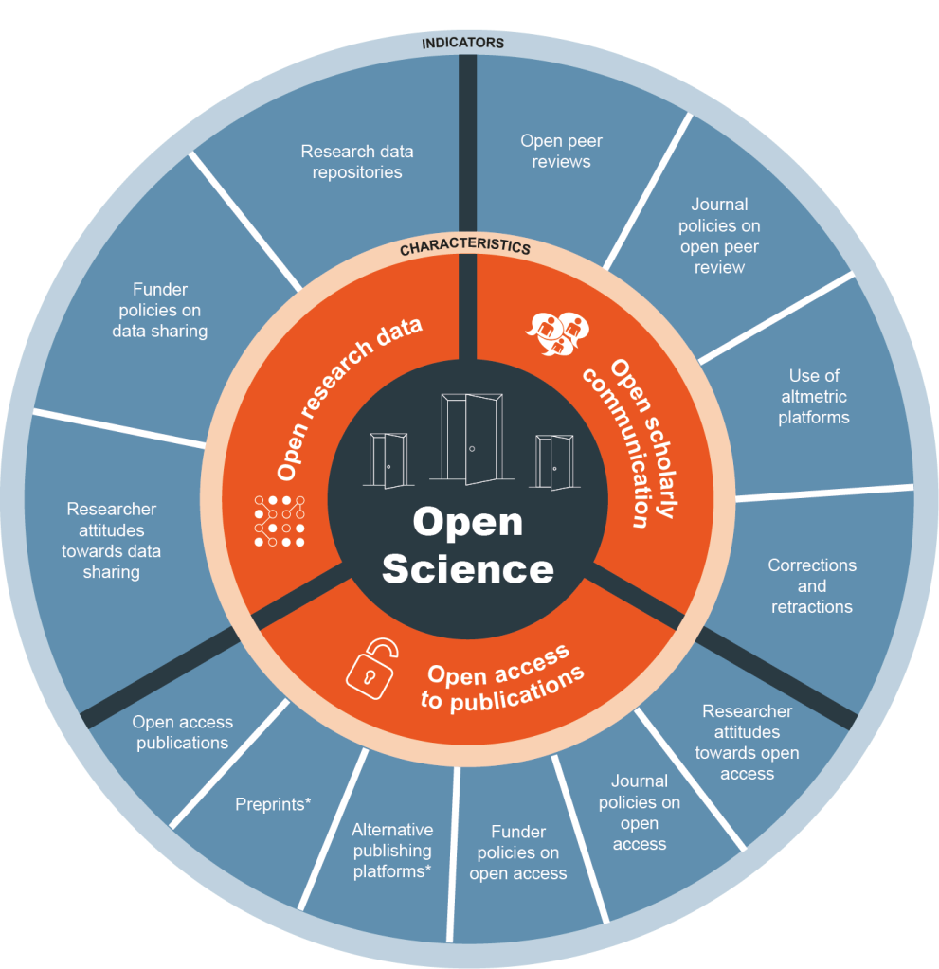
Open Science
Key emphasis: free flow of information
Technologically mediated collaboration
View of the research workflow and related governance
Set of values: transparency, reproducibility, inclusion
Promise of open science:
More openness = better research
Carlos Moedas, Open Innovation, Open Science, Open to the World (2015)

Slide 5
Simplistic vision of Open Science as
about unlimited access: making any research element available at any time for everyone
about the digital transformation: it is a novel phenomenon and completely dependent on ICTs
always good: it automatically improves the content of science as well as researchers’ working conditions
global: it can reach everybody with an interest in research, no matter where they are based
facilitating equity in research production and consumption: it makes previously inaccessible resources available to those who may wish to use them

Slide 6
But open science is not always good for research!

Slide 7
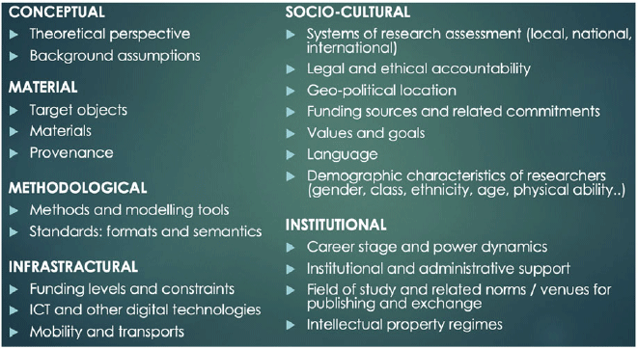
Problem 1: Epistemic Diversity
“the condition or fact of being different or varied in ways that affect the development and/or understanding of knowledge”
(Leonelli, 2023)

Slide 8
Problem 1: Epistemic Diversity
“gone are the days when it could appear uncontroversial to assume that Western sciences are or have ever been autonomous from society, value-free and maximally objective, or that their standard for rationality is universally valid”
(Harding 2011,)
One size does not fit all
Open science practices need to adapt to different research methods, settings and questions

Slide 9
Problem 2: Epistemic Injustice
Epistemic injustice: “wrong done to someone specifically in their capacity as a knower” (Fricker 2007)
Testimonial: systematic prejudicial credibility deficit
E.g. Farmers and breeders as knowers of crops
Hermeneutical: having one’s experience obscured from collective understanding owing to hermeneutical marginalization
E.g. Qualitative research as rigorous science

Slide 10
Problem 2: Epistemic Injustice
Open science tools produced by well-resourced institutions are not necessarily usable by researchers working under different conditions
Resources developed and circulated by researchers in low-resourced institutions can be easily exploited with little if any recognition

Slide 11
Methods
Detailed case studies
Data Science
Ethnographic fieldwork
Interviews with practitioners
Partnerships with key institutions
Participation in open science policy formulation

Slide 12
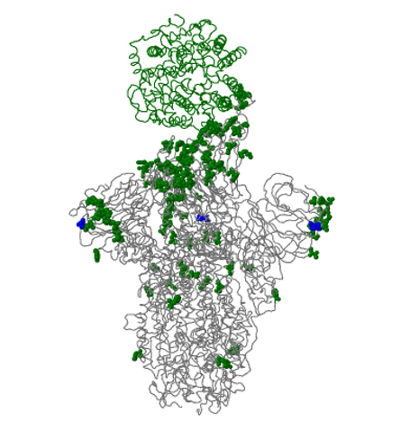
Case Study (1): SARS-CoV-2 Data Wars
Obvious urgency to identify and track SARS-COV-2 variants :
Genomes identify viruses​
Local transmissions vs Imported Cases​
Epidemic Growth​
Spread in different places or groups​
Transmission chains​
Genetic variation etc
Easiest data to share from technical perspective
Building on decades of efforts towards sharing of sequencing data (Leonelli and Ankeny 2012, Maxson-Jones et al 2018, Strasser 2019)
hCoV-19 spike glycoprotein mutations for BQ.1.1​
(GISAID,2023)

Slide 13

Accountable data sharing: Global Initiative on Sharing All Influenza Data
2008: share influenza genomic data securely and responsibly
an alternative to the public domain sharing model
Grounded on agreement governing data access and re-use
requires users to authenticate their academic identity and agree not to republish or link GISAID genomes without permission from data producer
fosters trust and information exchange among groups that differ in their geo-political locations, funding levels, material resources and social characteristics, thereby expanding the range of data sources shared online
Notes:
Launched on 100 year anniverdsary of 1918 Spanish flu
Based inGermany, now financed through agreement across private and public contributors (e.g. FIOCRUZ)
Since its launch GISAID plays an essential role in the sharing of data among the WHO Collaborating Centers and National Influenza Centers for the bi-annual influenza vaccine virus recommendations by the WHO Global Influenza Surveillance and Response System (GISRS).
* = I have two books and several articles on this issue, illustrating this with very in-depth examples, but no time now!

Slide 14
Accountable data sharing: Global Initiative on Sharing All Influenza Data
2020: redeployed as to include SARS-COV-2 data
EpiCov database stores, analyses and builds evolutionary trees of SARS COV-2 genome sequences
Now leading open access database for SARS-CoV-2, over 13 million genomes sequenced by November 2022
Key role in identifying and studying variants of interest, variant evolution and lineages, spread in real-time
Funded by public-private partnerships (Federal Republic of Germany, public-health and academic institutions in Argentina, Brazil, China, Republic of the Congo, Ethiopia, Indonesia, Malaysia, Russia, Senegal, Singapore, South Africa + bottom-up Friends of GISAID)
Notes:
Based inGermany, now financed through agreement across private and public contributors (e.g. FIOCRUZ)
Since its launch GISAID plays an essential role in the sharing of data among the WHO Collaborating Centers and National Influenza Centers for the bi-annual influenza vaccine virus recommendations by the WHO Global Influenza Surveillance and Response System (GISRS).
* = I have two books and several articles on this issue, illustrating this with very in-depth examples, but no time now!

Slide 15
Not open enough?
29/01/2021: government board of European Bioinformatics Institute posts letter in Nature calling for greater openness in sharing SARS-CoV-2 genome data
Worry: limiting the extent to which data can be accessed and linked can negatively affect the insight, pace and breadth of future research
“to unleash the fast flow of research advances” the scientific community must remove all formal barriers which restrict data sharing and share all SARS-CoV-2 genome sequences
signed and promoted by Nobel Laureates, directors of bioinformatics programs and many leading researchers concerned about urgency of an effective pandemic response
Notes:
“to unleash the fast flow of research advances” the scientific community must remove all formal barriers which restrict data sharing and share all SARS-CoV-2 genome sequences to one of a triad of state genomic surveillance programs (EBI, The GenBank of USA and the DNA Data Bank of Japan)

Slide 16

Pushing for actionable data: COVID-19 Data Portal
EU/EMBL/Elixir alternative since April 2020
“accelerating research through data sharing”, ca. 6 million sequences to date
bulk downloads with no user tracking
strong emphasis on interoperability
includes / links with wide variety of data, including protein, expression, networks, imaging, even socio-economic data
Actionability: capacity to re-purpose data for novel goals and research settings
Different from highly specific understandings of actionability within biomarkers research in oncology (Plutynski and Chin-Yee)

Slide 17
Planned Work
Empirical paper:
Sheehan, N., Leonelli, S., Botta, F., 2023: From Collection To Analysis: A Comparison of GISAID and The Covid-19 Data Portal
(in review @ codata data science journal)
Philosophy Paper:
Sheehan, N., Leonelli, S., 2023: What can data represent? Reconciling Actionability And Accountability Requirements for Research Data (presenting @ The International Society for the History, Philosophy, and Social Studies of Biology June 2023)

Slide 18
Empirical Paper
(1) architecture - the underlying computational systems and infrastructure that enable the functioning of data infrastructures, providing insight into the structural and organizational conditions that shape the production and dissemination of data;
(2) submissions - the demography of contributors that are interacting with the architecture; and
(3) usage - the situated experience of data communities who interact with data infrastructures in order to produce new outputs of knowledge.

Slide 19
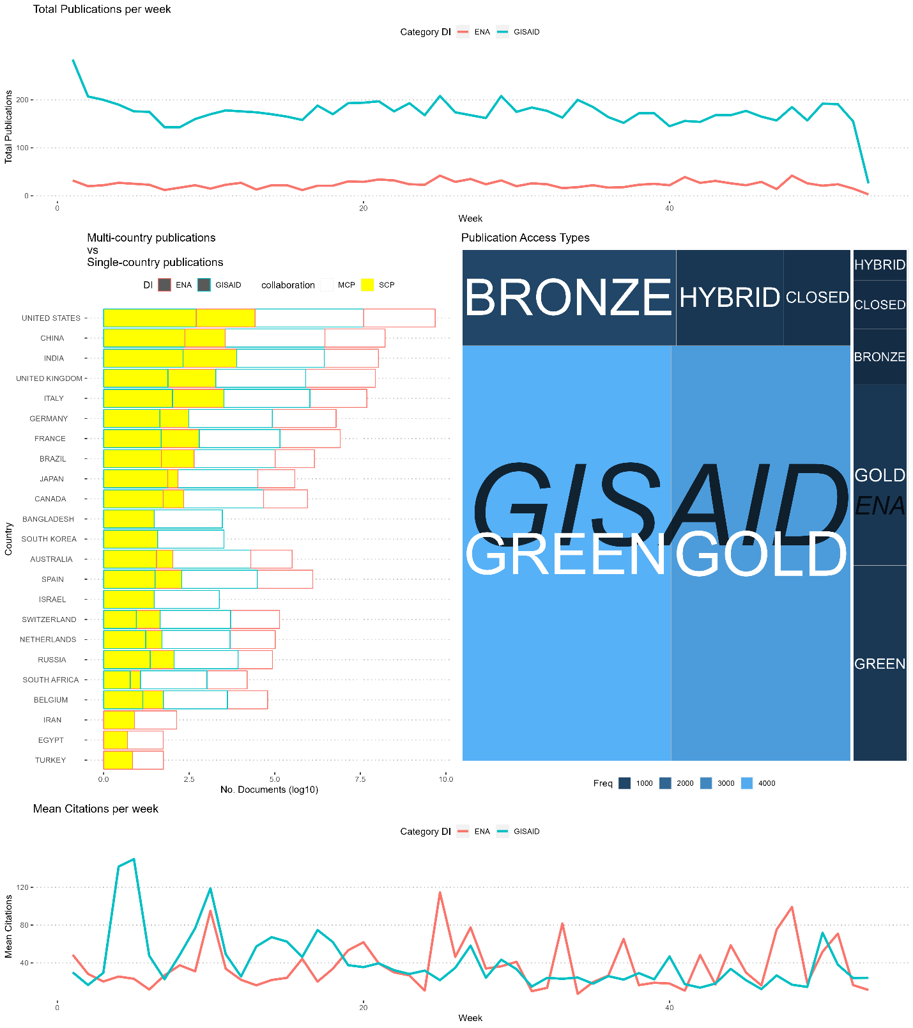
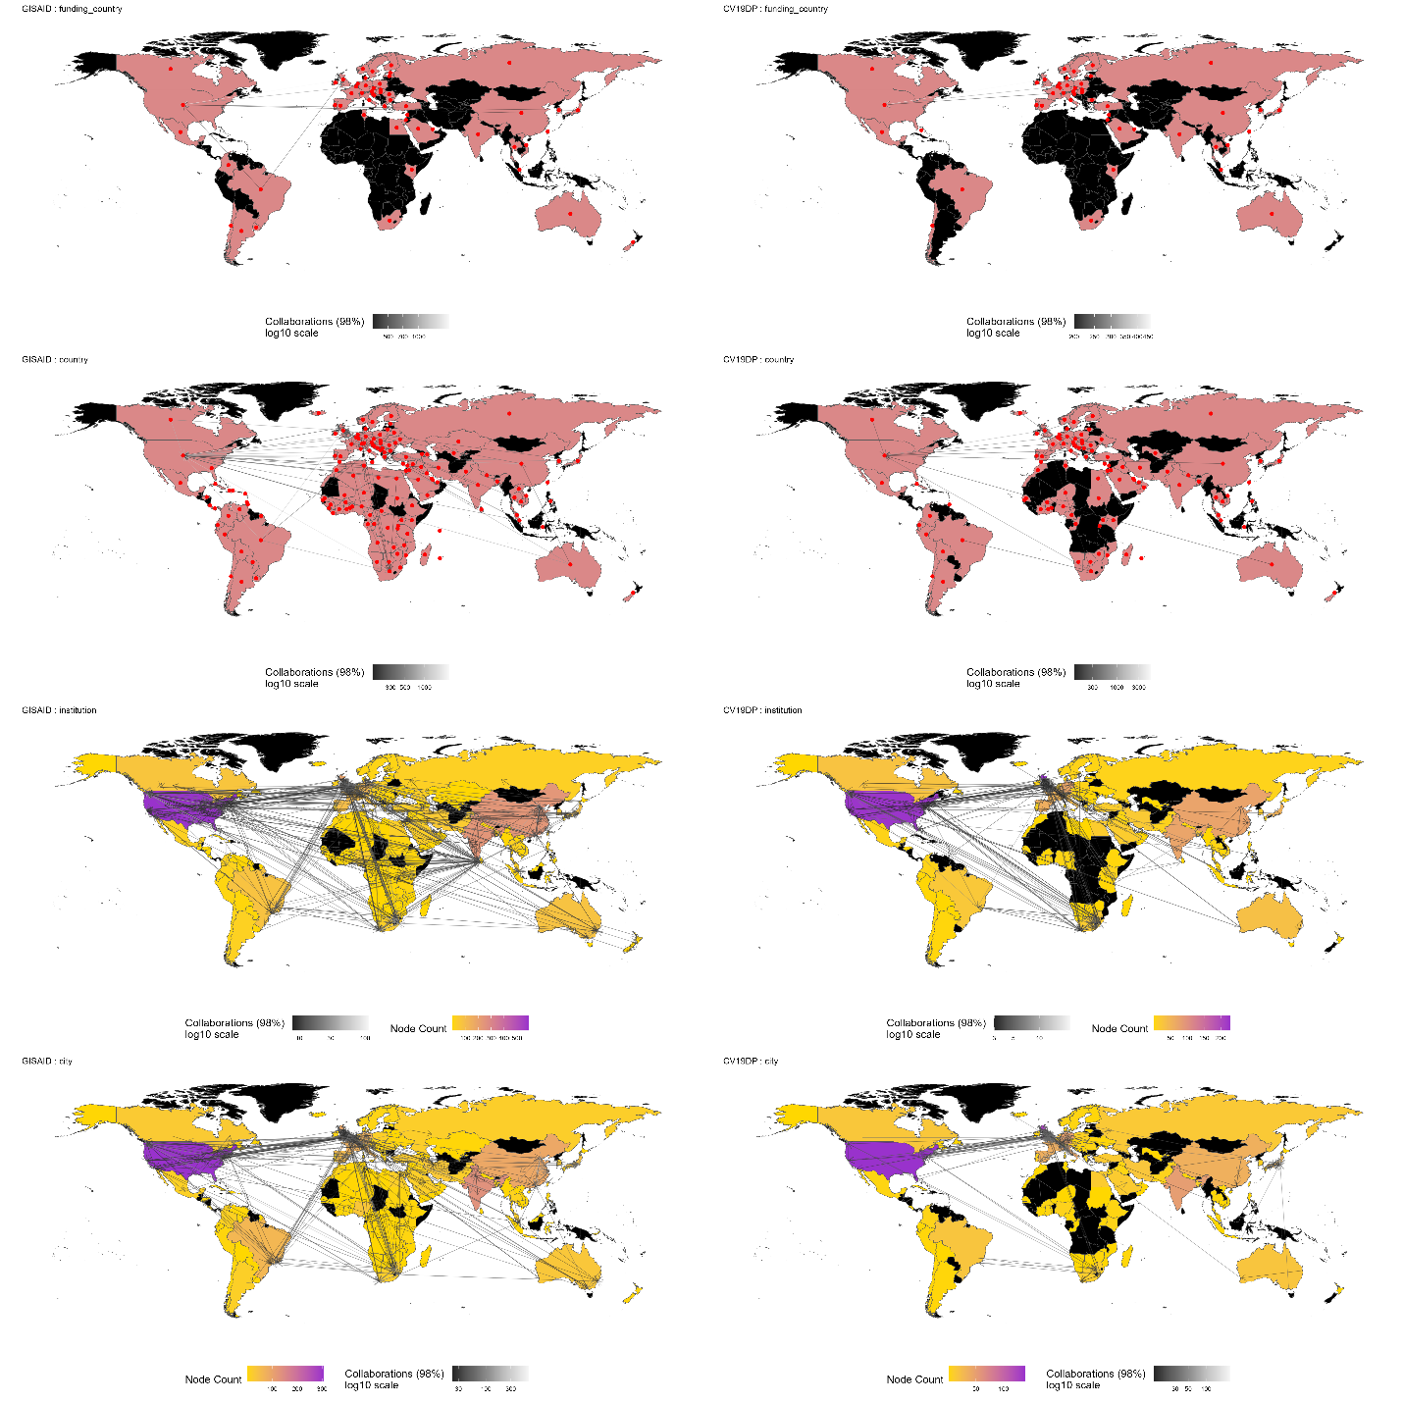
Results

Slide 20
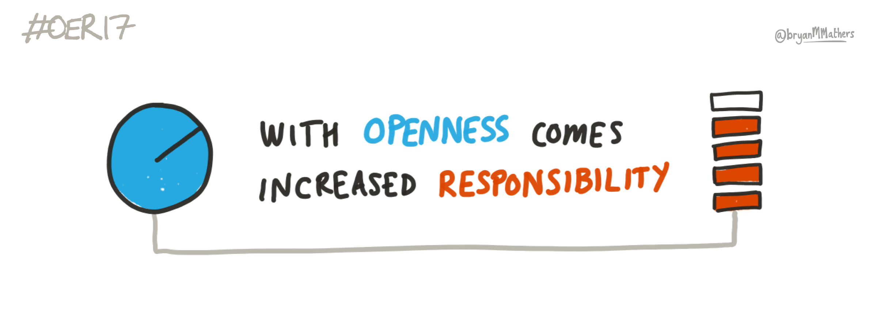
Philosophy of Science Paper
Perceived trade-off between accountability and actionability of data
C19DP: priority on making data “reusable”, rather than just accessible
open data to unexpected re-purposing through interoperable standards/tools
GISAID: priority on enhancing comprehensiveness of coverage and accountability to sequence ‘donors’
Science is not a level playing field + methodological cutting-edge does not necessarily support inclusion and trust
need to ensure representativeness of data samples through appropriate data governance and tech choices
An ongoing challenge, at once ethical and epistemic: Different interpretations of openness and responsible research
?
openLab des Universitätskolleg DIGITAL der Universität Hamburg
Notes:
On the one hand, engaging in data sharing efforts only makes sense if data can be used to support discovery, thereby becoming ‘actionable’ - a consideration that leads some advocates of open data to argue that any constraint on data circulation constitutes an obstacle to knowledge production.
On the other hand, data infrastructures need to be accountable both to data contributors and to data users, which may involve restrictions on who may donate, access and reuse the data
–
Our argument: Severe challenge but not a trade-off ents for actionability and accountability of data platforms are conceptualised as incompatible and leading to a tradeoff situation where increasing one will unavoidably decrease the other.
--

Slide 21
Overcoming the ‘trade-off’ framing
Data actionability is not just about technical opportunities (linkage, standardization, interoperability, multi-scale modelling)
Actionability includes management of transdisciplinary expertise of relevance to data interpretation..
..and investment in trustworthy governance to increase participation and thereby accountability of data
[Leonelli 2016, 2018, Tempini and Leonelli 2019, Beaulieu and Leonelli 2021]
Notes:
What does invoking the idea of trade-off indicates?○Trade-off according to the CambridgeEnglish Dictionary:▪”A balancing of two opposing situations or qualities, both of which aredesired”▪“A situation in which the achieving of something you want involves the lossof something else which is also desirable, but less so”○Consider: Accountability to data contributorsversusactionability of data themselves.○Within Open Science debates, often framed as a trade-off: needing to choosebetween the two, with people taking sidesIn our view, this framing▪is unnecessary▪hampers data sharingefforts▪is grounded on a problematic understanding of Open Science as a wholeThis becomes clear when focusing on common concern to both sides: data representativeness

Slide 22
From Open Science as indiscriminate sharing..
Transparency
Quality
Inclusion
[diversity & justice]
Leonelli, S (under revision) Philosophy of Open Science. Elements, Cambridge University Press

Slide 23
..to Open Science as inclusive and judicious connection
Transparency
Quality
Inclusion
[diversity & justice]
Inclusion
[diversity & justice]
Quality
Transparency
Leonelli, S (2023) Philosophy of Open Science. Elements, Cambridge University Press
Notes:
I propose a conception of openness as judicious connection, which is grounded in a process-oriented epistemology of science that recognises the situated, embodied and goal-directed nature of communication and collaboration among researchers.
What does “connection” have to do with openness?
The idea of openness is quintessentially linked to that of learning as going beyond one’s boundaries. This arguably applies to systems of research practice as much as to research groups and individual learners: establishing new connections often means expanding one’s learning, challenging existing assumptions around what is considered external or irrelevant to a given system, and considering whether new boundaries need to be established that incorporate the novel relations.
Importantly, Leonelli does not equate an indiscriminate increase in scientific connections with an increase in open science. Instead,
the building and maintenance of connections need to be judicious: they require skilled deliberation, whereby the new opportunities offered by the connection in question are evaluated within the contexts at hand. Indeed, openness can itself be understood as a dynamic and highly situated mode of valuing the research process and its outputs, which encompasses economic as well as scientific, cultural, political, ethical and social considerations (Levin and Leonelli 2017).
The differences between the object-sharing and “judicious connection” approaches to open science also have implications for inclusion. The standard object-sharing approach assumes that greater transparency leads to a more inclusive science. In contrast, Leonelli’s “judicious connection” approach flips the causal arrow and assumes that more inclusion leads to greater transparency.
The implementation of OS [open science] needs to start from consideration of what it may take to make research more inclusive, diverse and just – rather than expecting such an outcome to naturally follow from the ‘right’ choice of software, infrastructures, standards, publishing platforms, or whichever other technological or institutional fix is being devised to facilitate access to resources.

Slide 24
Conferences and Events 2023
Chinese delegation right after the Royal Society Summit on Human Germline Genome editing February 2023
Research Data Alliance's 20th Plenary March 2023
Whither Open Science? PHIL_OS Exploratory Conference March 2023
The International Society for the History, Philosophy, and Social Studies of Biology June 2023
Governing Global Health Data: Key Tensions with Sovereignty, Access and Equity September 2023

Slide 25
Upcoming Work
Finish draft of philosophy paper (June)
Fieldwork with GISAID and CV19DP as a data curator (September-December 2023)
Possible visit to Cameron Neylon @ the University of Perth for developing a diversity index for the COKI Open Access Dataset Project (December 2023-March 2024)
Expanding the Empirical Methodology to other Databases (March-June 2024)
History of Openness in Software Cultures 1980-2020 (June – September 2024)
Thesis Writing (September 2024 – Finish 2025)
Notes:
Liden

Slide 26
Peace and Love to Gaia
Thanks for listening x
Any
Questions?

